Slide 1
Artificial Intelligence Boosting w/out Code
Self-Service AI & Deep Learning
William Hill
Lead Data Scientist
william.hill@vion.com
github.com/will-hill

Slide 2
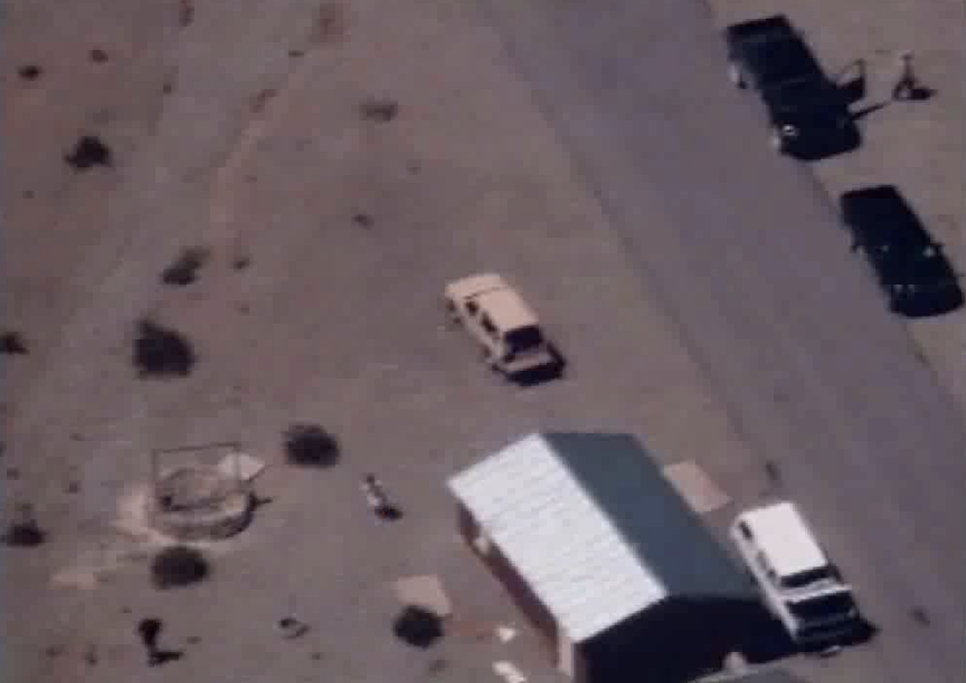

Slide 4
false positive

Slide 5
false positive
false negative

Slide 6
false positive
true positive
false negative

Slide 7
false positive
true negative
true positive
false negative

Slide 8
false positive
true negative
How do we fix these?
true positive
false negative

Slide 9
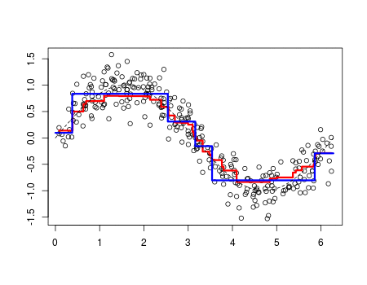
Boosting
“update weights of incorrectly classified images”

Slide 10


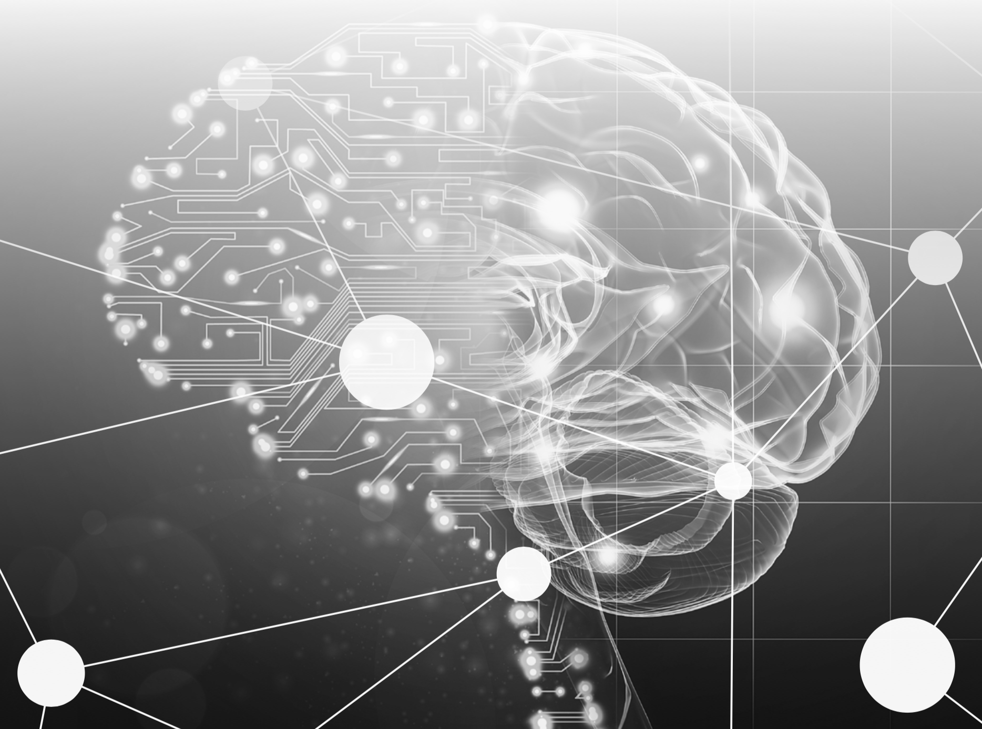





Boosting
person
not person

Slide 11
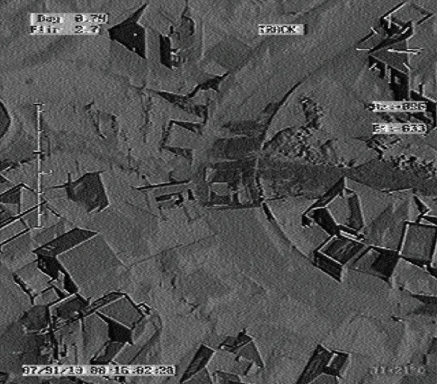
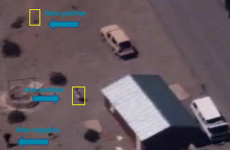
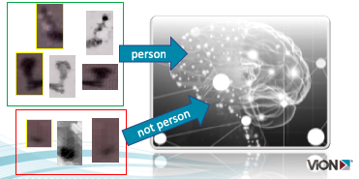
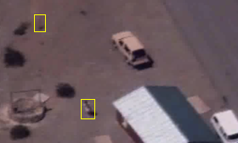
DevOps Cycle
production
validate
induce algorithm
inference

Slide 12
Customer Requirements
Complex GOTs solution lacking support
Boost accuracy, avoid re-certification
Improve performance – induction / inference speed
Easy Button

Slide 13
Give me an ‘easy button’
Dataiku

Slide 14
Enterprise, End-to-End, Self-Service
Artificial Intelligence
Deep Learning
Machine Learning
Data Science

Slide 15
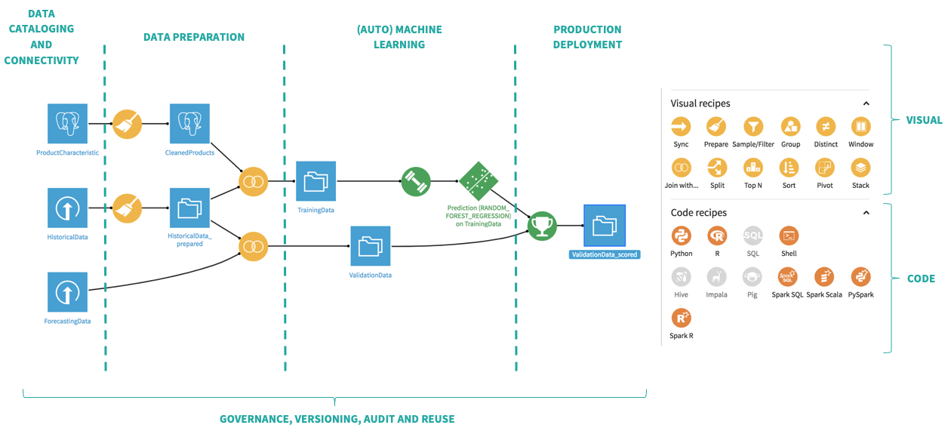

Slide 16
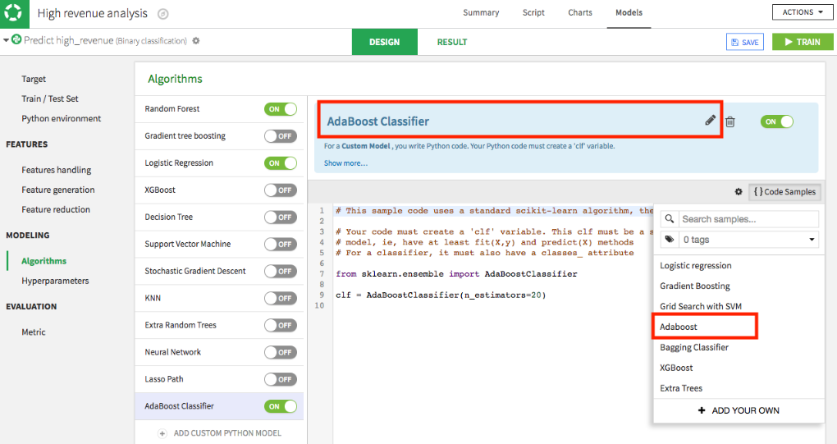
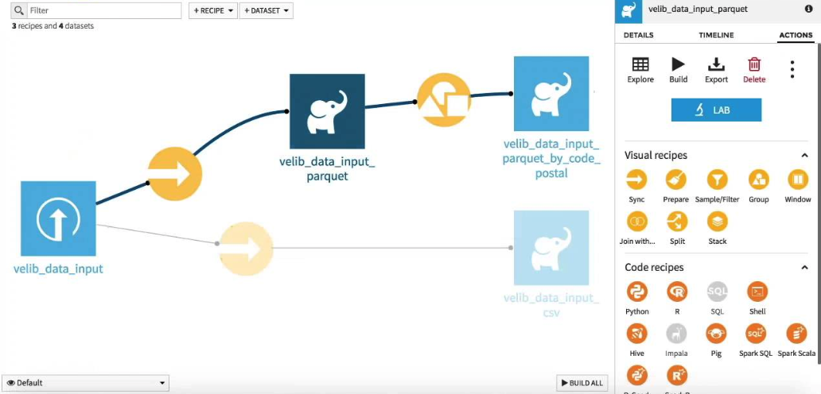
Click & Drag Modeling & Boosting

Slide 17
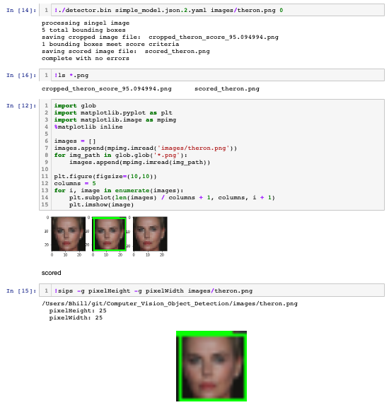
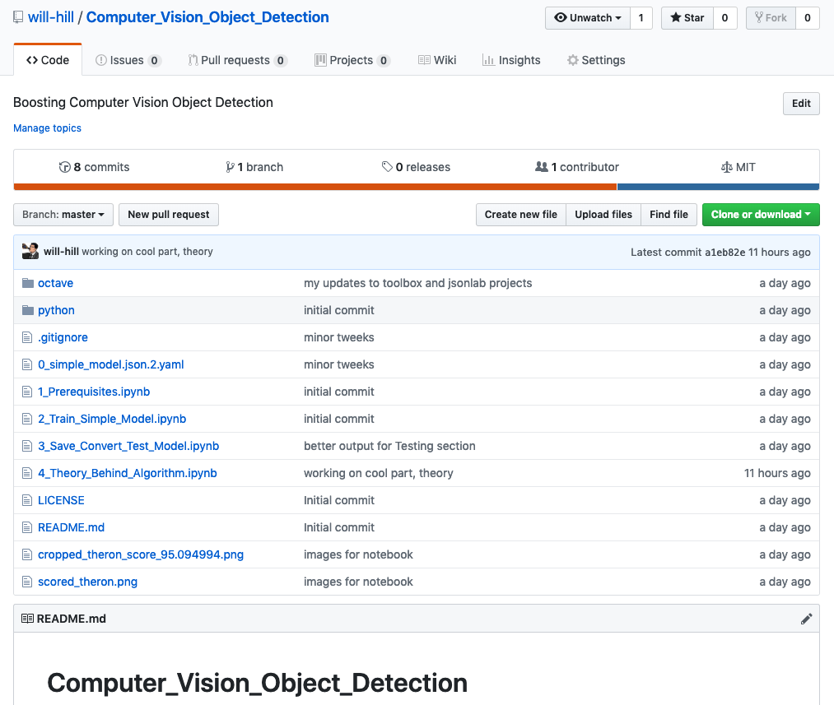
Jupyter Notebook Proof-of-Concept
Notes:
https://www.youtube.com/watch?v=LsK-xG1cLYA

Slide 18
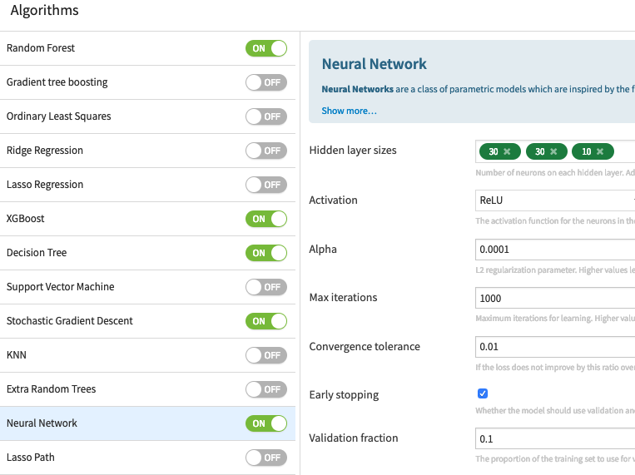
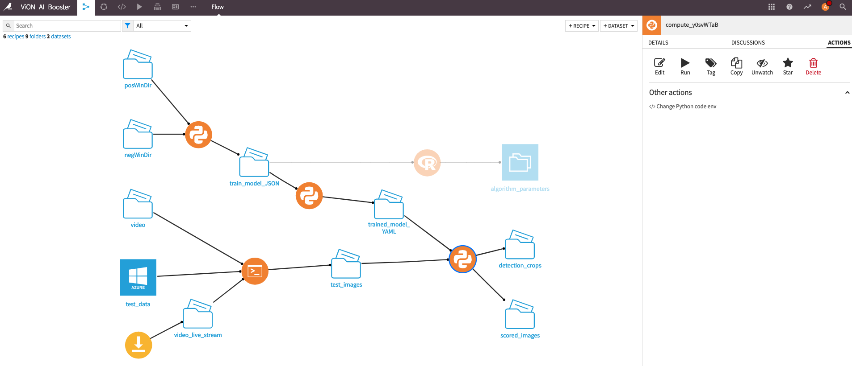
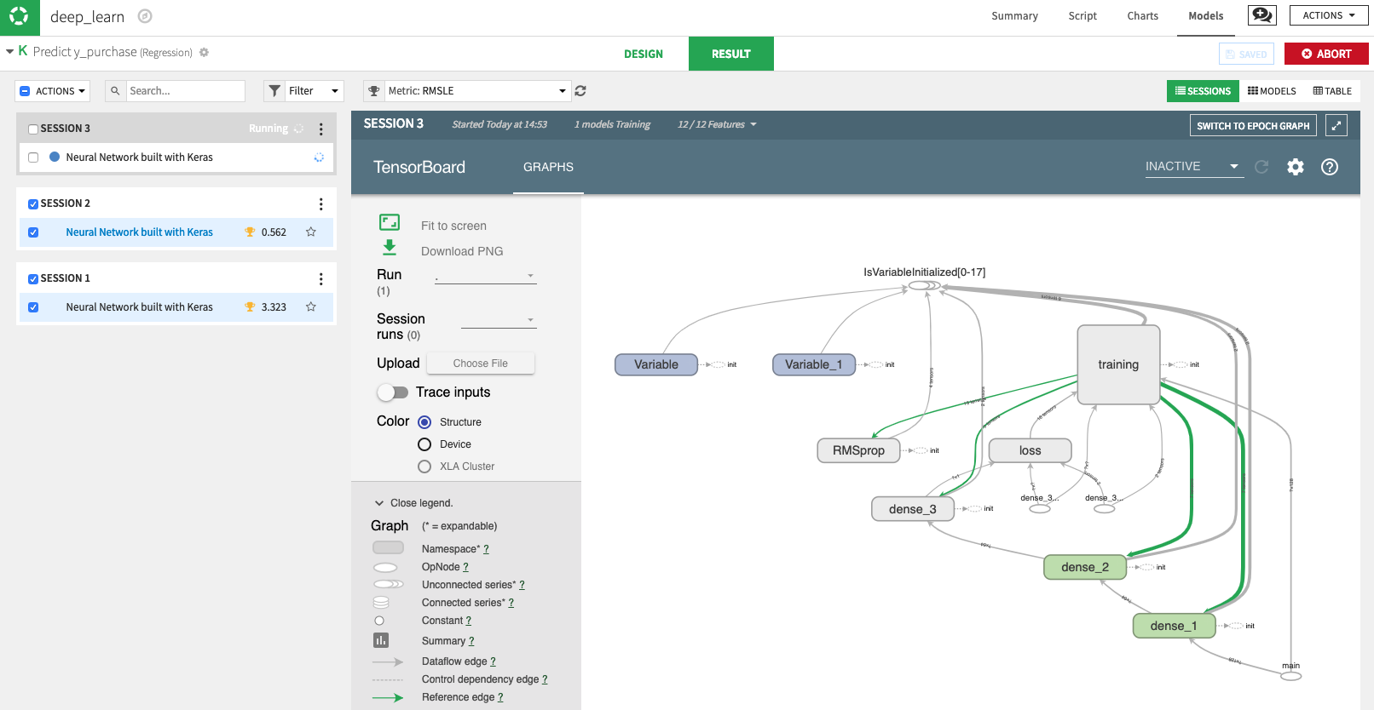
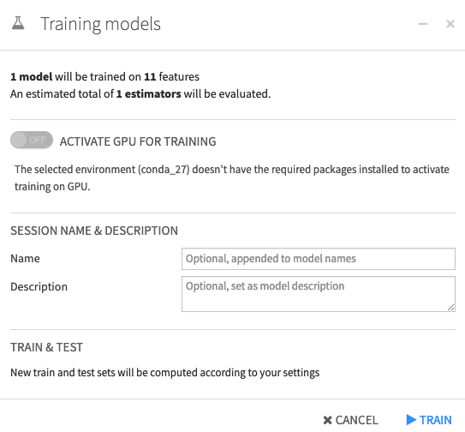
Easy Button Dataiku
easy button
induce / build
GPU optimize (if possible)
Notes:
https://www.youtube.com/watch?v=LsK-xG1cLYA

Slide 19
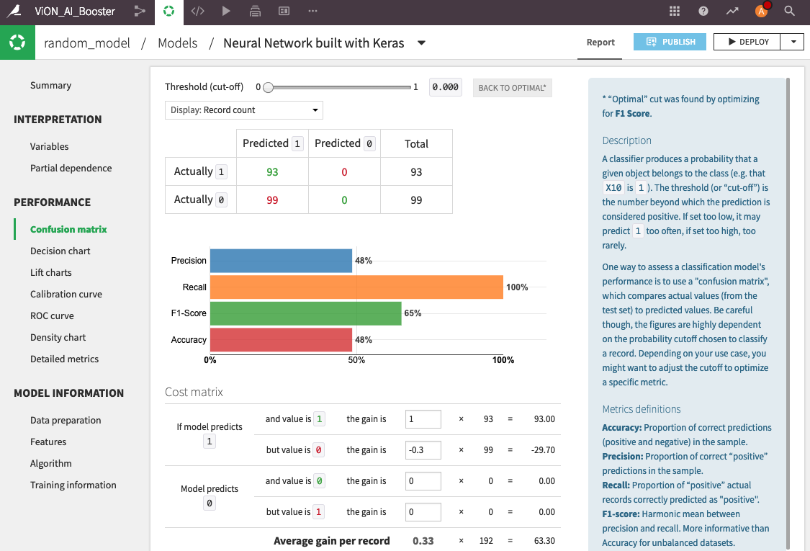
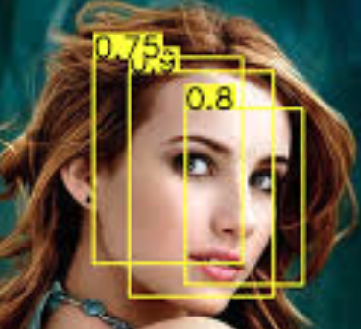
Easy Button Dataiku
deploy
Notes:
https://www.youtube.com/watch?v=LsK-xG1cLYA

Slide 20
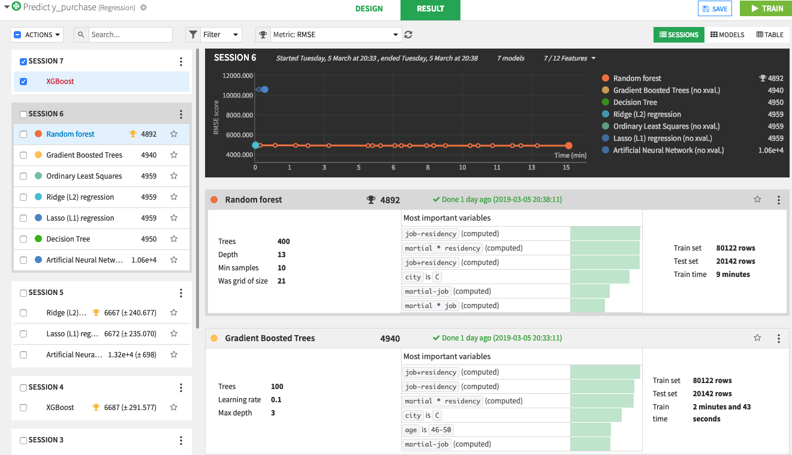
Easy Button Dataiku
test / validate
Notes:
https://www.youtube.com/watch?v=LsK-xG1cLYA

Slide 21
Easy Button Dataiku
production
Notes:
https://www.youtube.com/watch?v=LsK-xG1cLYA

Slide 22

Warning
Algorithm Explained

Slide 23
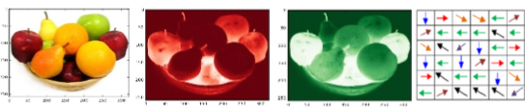
Algorithm Explained
image pyramids
aggregate feature channels (afc)
train adaboost tree ensemble
non-maximal suppression (nms)

Slide 24
What is an image or frame?

Slide 25


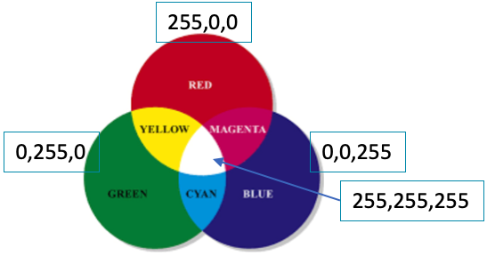

Matrix of Pixels
R:112
G:26
B:20
R:109
G:49
B:39
R:188
G:56
B:49
R:95
G:45
B:27
Matrix of pixels
Each pixel is typically 3 integers
Intensities of red, green, blue (rgb)

Slide 26

Convolution Explained
convolution
image
kernel

Slide 27
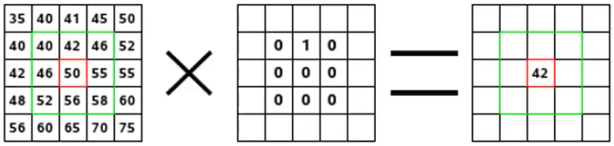
Convolution – kernel applied to pixels
images pixels
kernel
convolution

Slide 28
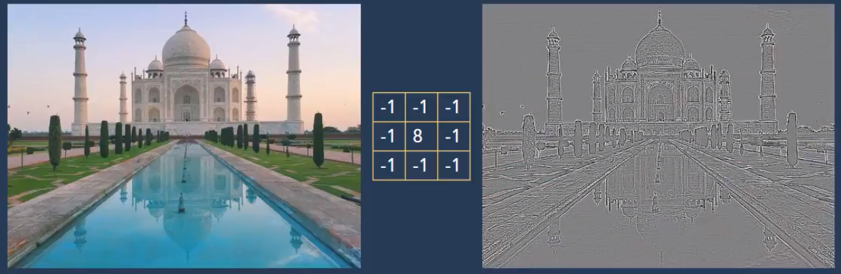
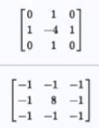
Example Kernel – remove neighbor color
Continuous areas -> grey
Discontinuities -> black & white lines

Slide 29
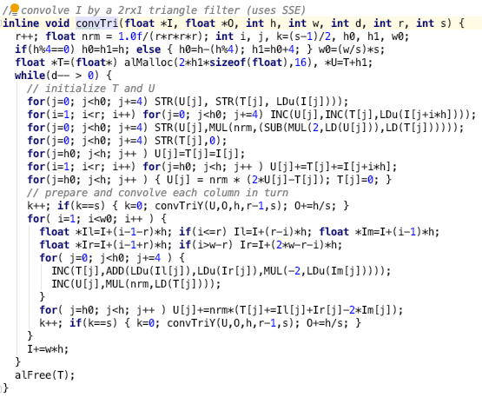
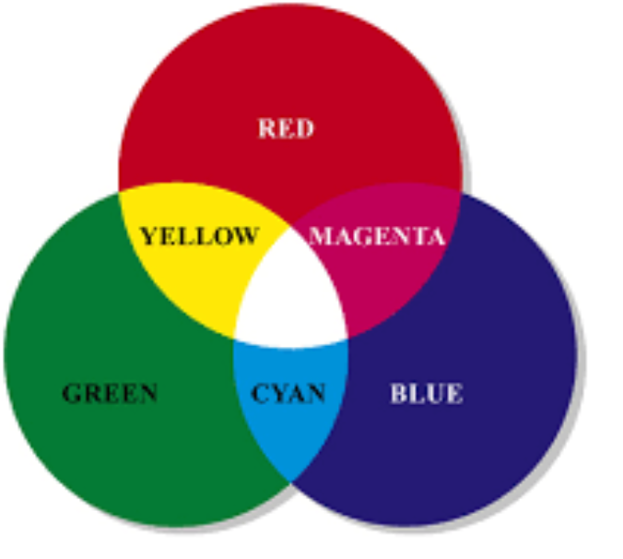
Channels Colors
So many for loops…
ripe for GPU optimization
red
green
blue
255,0,0
0,255,0
0,0,255
255,255,255

Slide 30
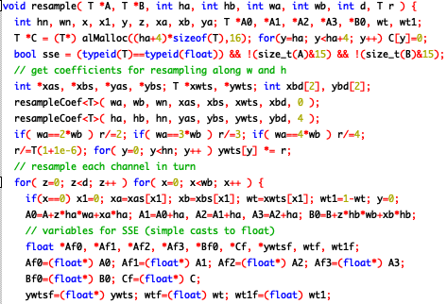
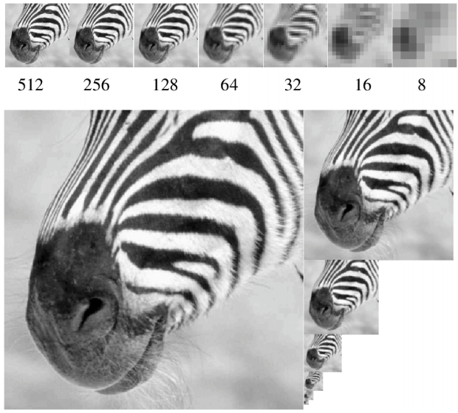
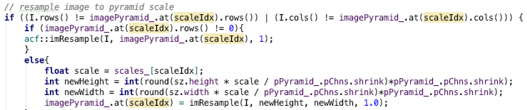
Image Pyramids
looped computations; embarrassingly parallel
order of magnitudes faster with GPU

Slide 31
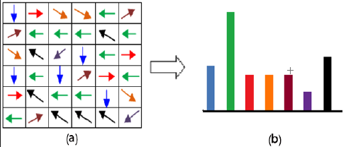
Channels Gradients, Histograms
12 | 34 | 143 | 201 | 255
12 | 34 | 143 | 201 | 255
12 | 34 | 143 | 201 | 255
12 | 34 | 143 | 201 | 255
12 | 34 | 143 | 201 | 255
Gradient Direction/Orientation
As Histogram
Gradient Magnitude

Slide 32
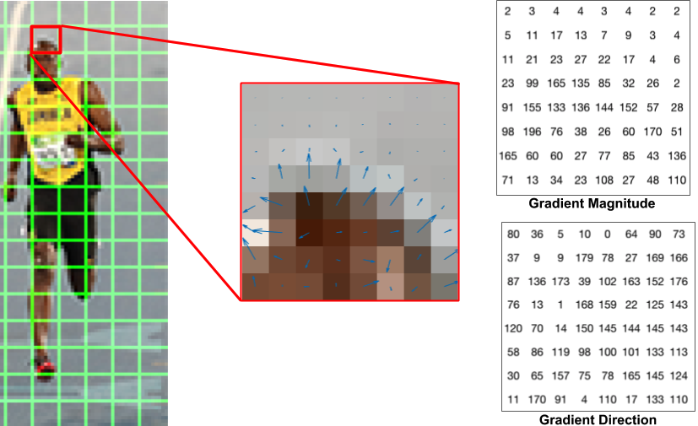
Another Gradient Explanation

Slide 33
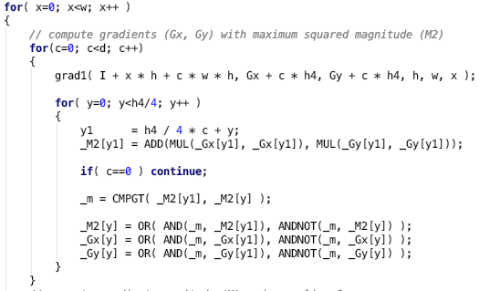
Gradient Calculations
nested for loops;
perfect for GPUs

Slide 34
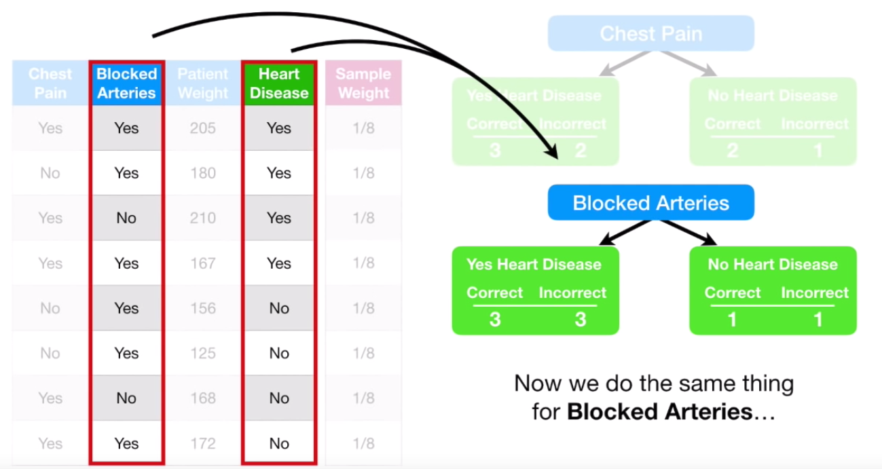
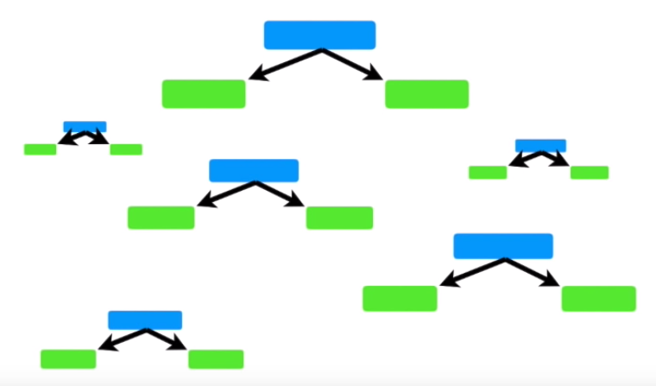
AdaBoost Ensemble Weighted Decision Trees
AdaBoost
Gradient Boosting
XGBoost
Notes:
https://www.youtube.com/watch?v=LsK-xG1cLYA

Slide 35
AdaBoost Ensemble Weighted Decision Trees
bounding boxes with probability

Slide 36
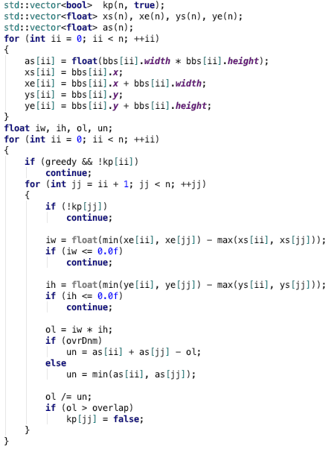
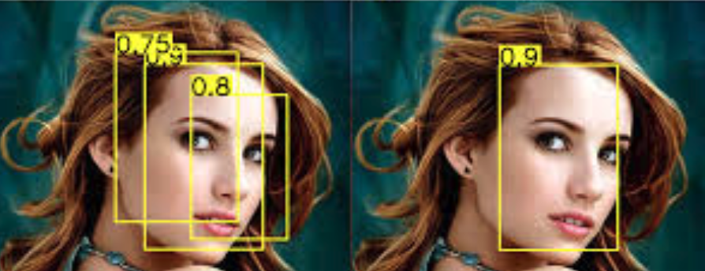
Non-Maximal Suppression
1. overlap?
intersect area / union area > 0.5 ?
2. if overlap, choose best score
nested for loop computations;
begging for GPU

Slide 37
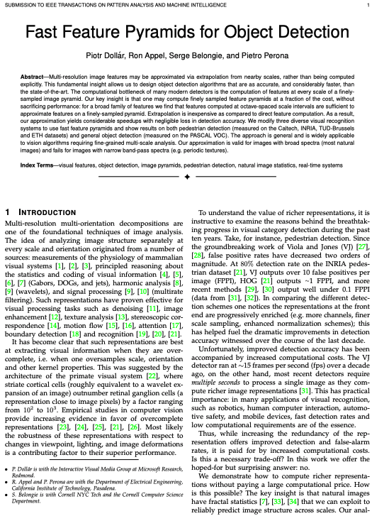
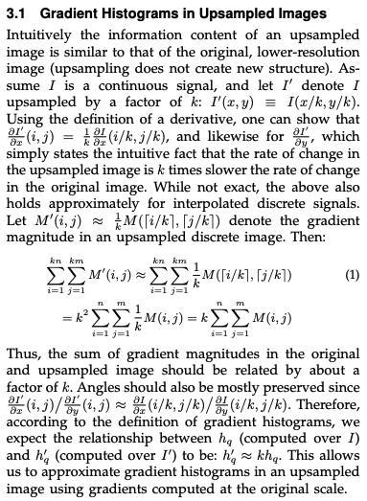
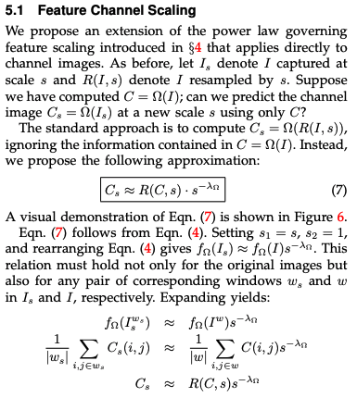
Object Detection w/ Fast Feature Pyramids

Slide 38
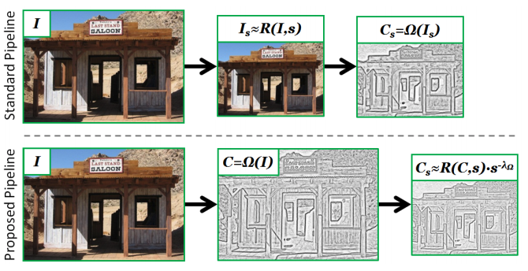
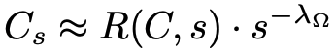
Object Detection w/ Fast Feature Pyramids
“natural images have fractal statistics that we can exploit to reliably predict image structure across scales”

Slide 39
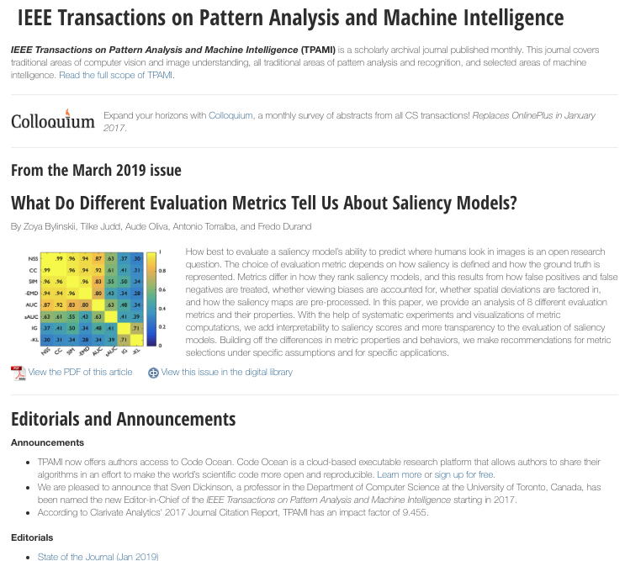
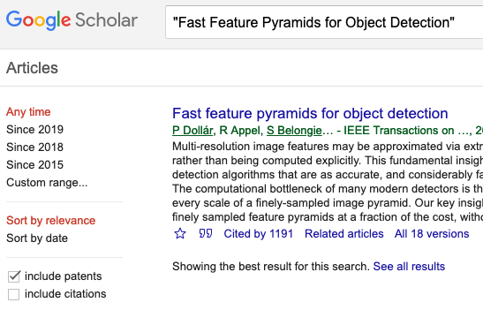
14 dense pages https://eeexplore.ieee.org/xpl
Cited 1191 times!!!

Slide 40
Questions?
Self-Service AI & Deep Learning
William Hill
Lead Data Scientist
william.hill@vion.com
github.com/will-hill

